Slide 1
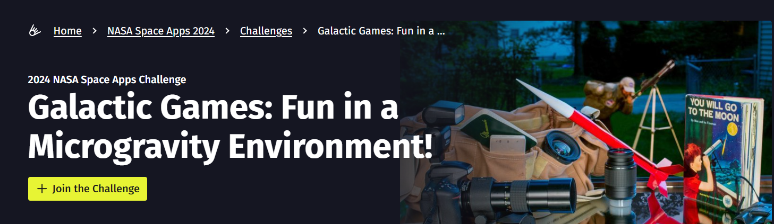
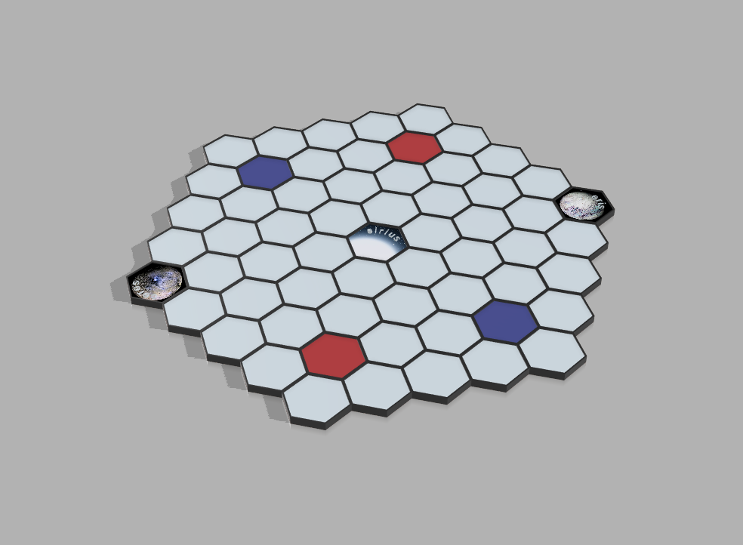
Hexapace: A space conquest game across the universe!
Team Hiperbol
Boran Doruk Adsay
Lorin Arslan
Mehmet Furkan Erdem
Ömer Efe İyicioğlu
Interactive Game Board

Slide 2
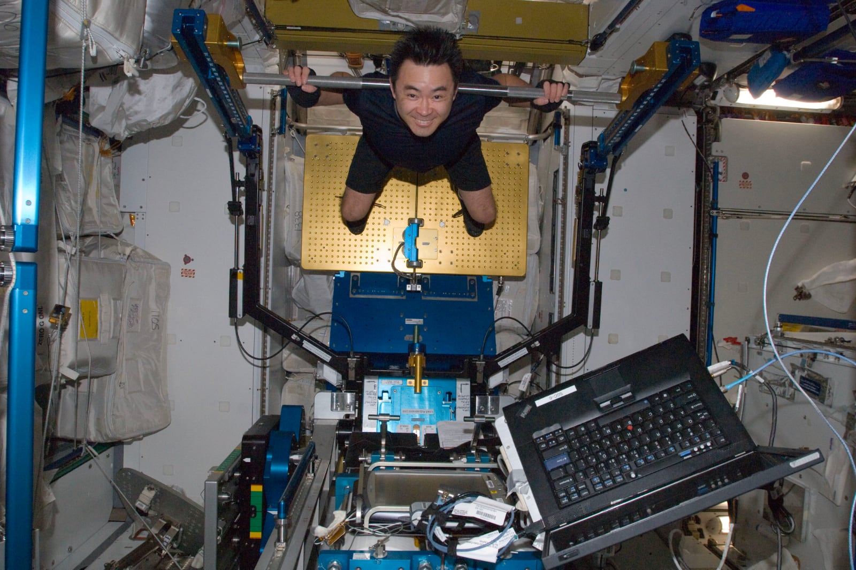
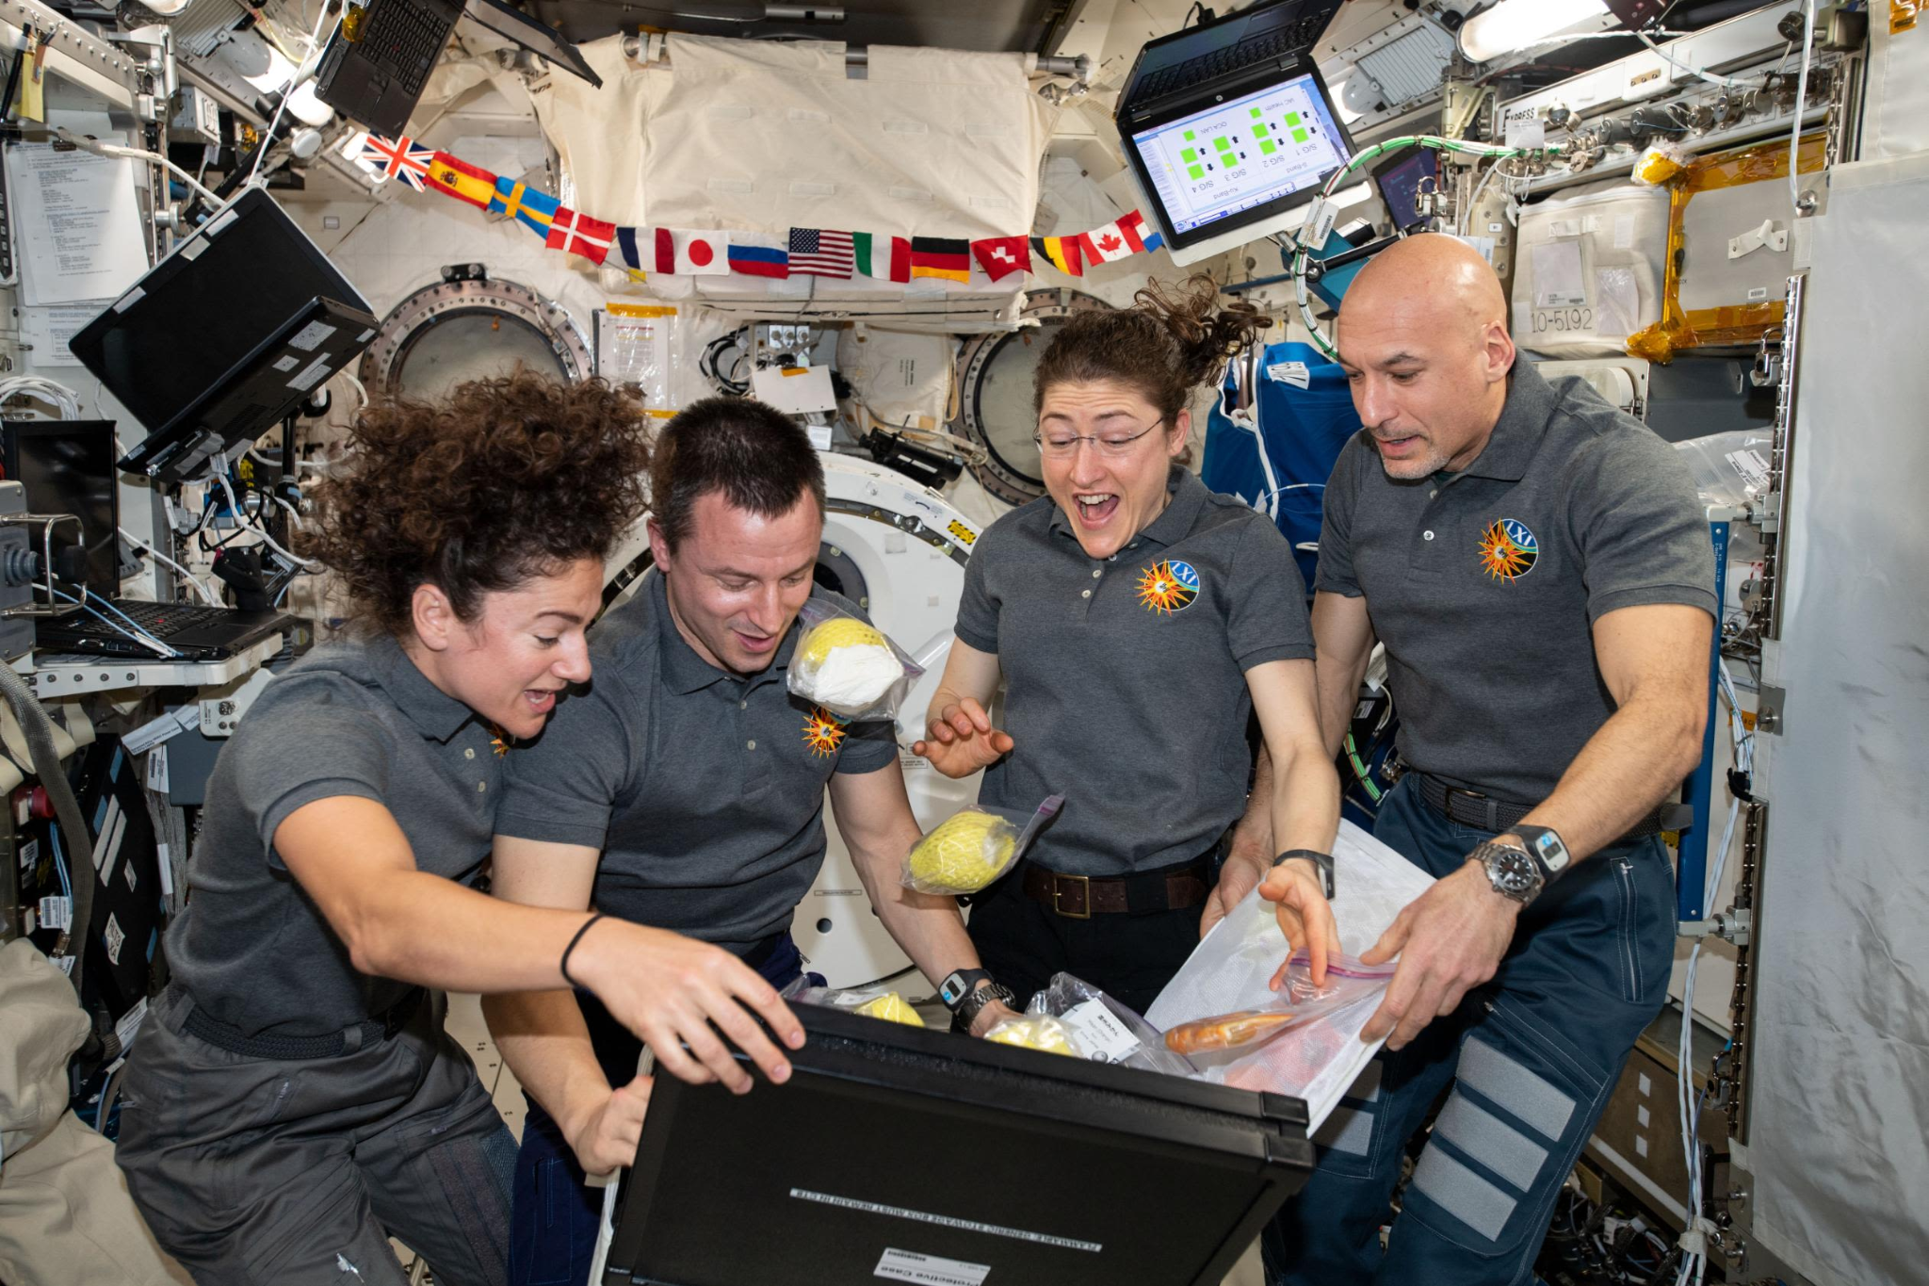
Game design-Inspiration
Considering the difficulties astronauts face while in space, we thought they needed some fun to keep them mentally well! This game also helps them to stay active while playing so it contributes to their physical well being as well.
This board game is designed specially for astronauts in microgravity. It has innovative technologies which uses the benefits of the microgravity. We did not use any game pieces other than 5 “cardlets”, an interactive game board and a log tablet.
https://humans-in-space.jaxa.jp/en/assets/images/life/health-in-space/life/img02_01.jpg
https://www.nasa.gov/wp-content/uploads/2023/03/iss061e004031.jpg

Slide 3
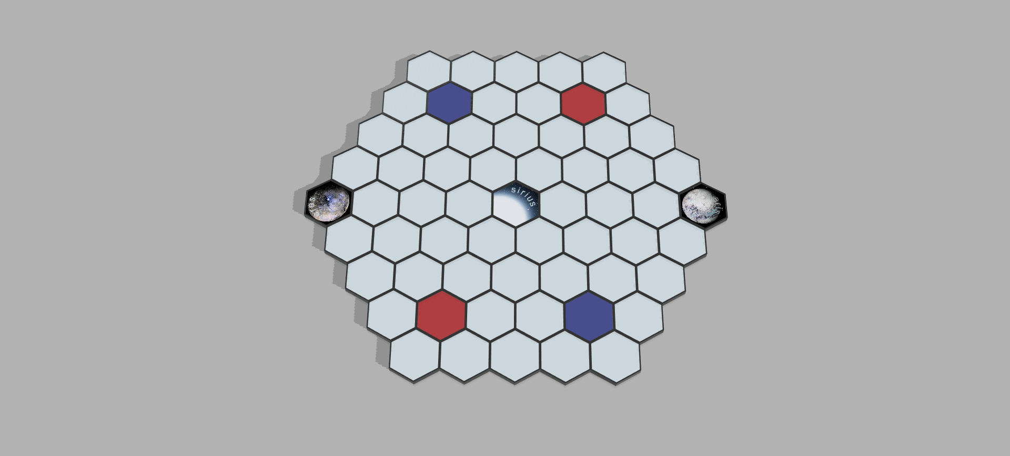

How to play ?
Player take space by touching the hexagons on the board. The areas that they touch must be connected to each other and the count of the moves must add up to the chosen card’s values. In one turn a team can only conquer 2 hexagons of the opponent side.
Interactive Game Board in Action
Final Log Tablet Design

Slide 4
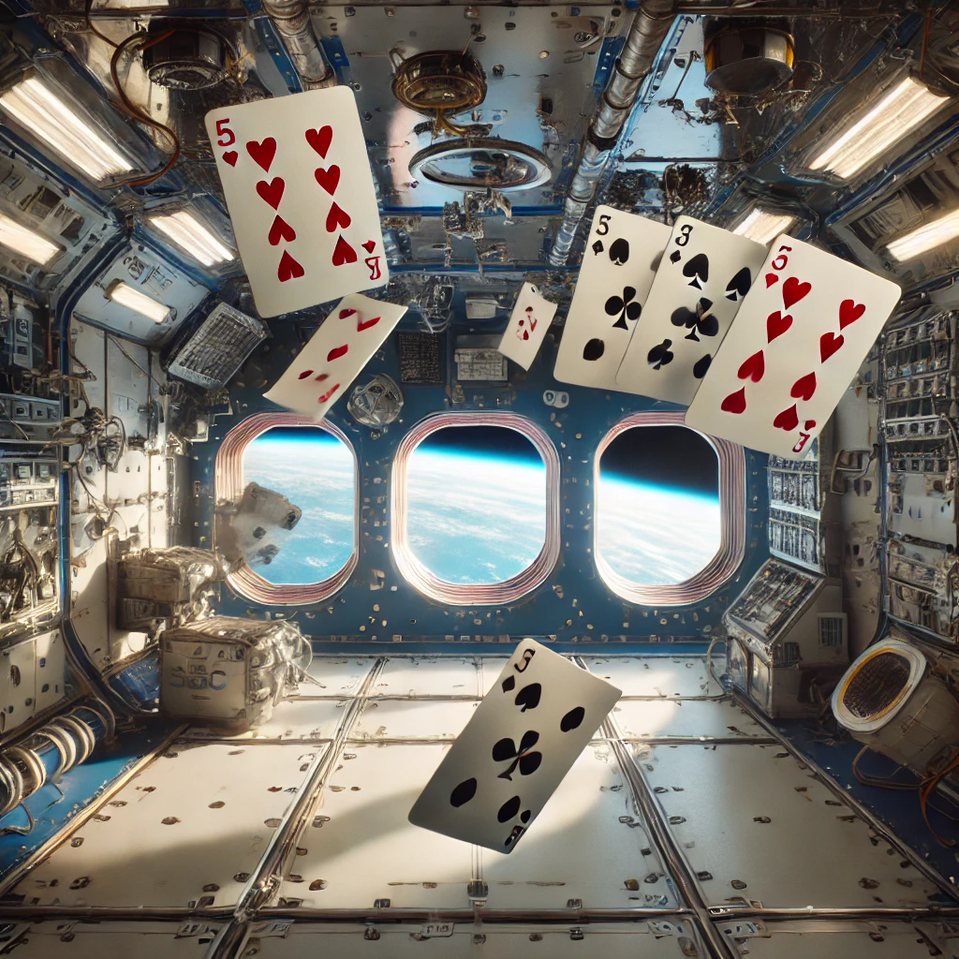
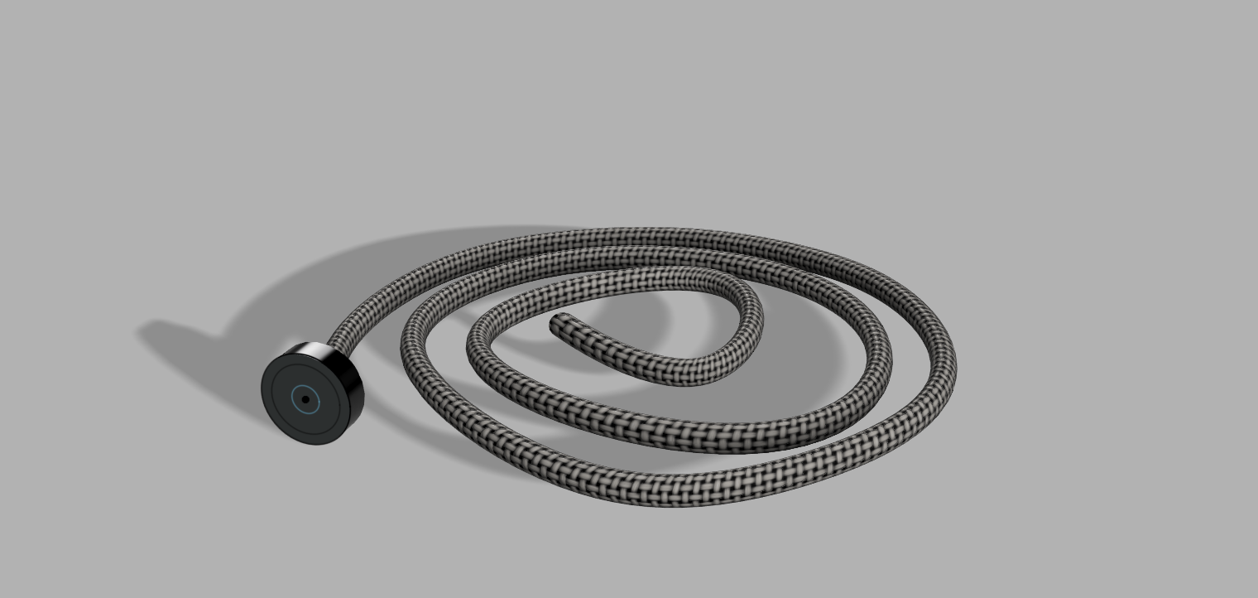
Hook System
If a team chooses to take land they need to fish from the flying magnetic “cardlets”. If they can fish a card successfully in a single attempt they will have one award and one punishment according to their card number. Players can see which award and punishment they get, from the Hexapace Log Tablet. However if they cannot hook any card their turn will be skipped to the other team.
It is a risky but a rewarding system.
If a team chooses to take land they need to “hook” one of the flying magnetic “cardlets”. If they can “hook” a card successfully in a single attempt they will have one award and one punishment according to their card number. Players can see which award and punishment they get, from the “Hexapace Log Tablet”. However if they misshook any card their turn will be skipped to the other team.
It is a risky but a rewarding system.
Representative
Chat GPT AI image
Final Model

Slide 5
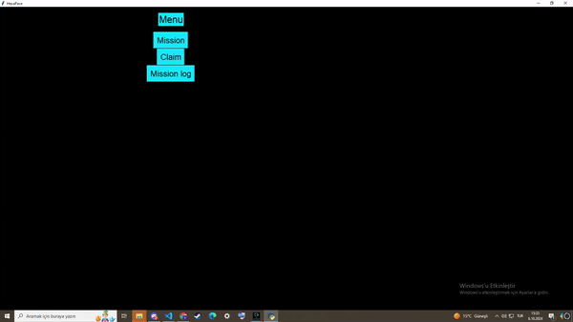
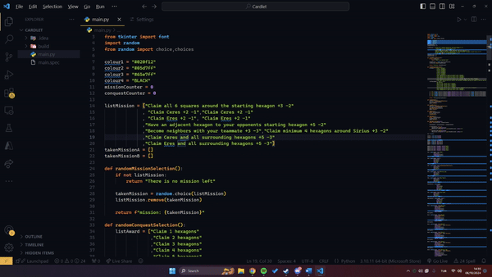
Randomized Conquest System
If a team chooses to take land they need to fish from the flying magnetic “cardlets”. If they can fish a card successfully in a single attempt they will have one award and one punishment according to their card number. Players can see which award and punishment they get, from the Hexapace Log Tablet. However if they cannot hook any card their turn will be skipped to the other team.
It is a risky but a rewarding system.
In this game, each time a “cardlet” is hooked, it has random reward and penalty values within the log system according to the number written on them. Based on these values, players can gain or lose their territories.
The “cardlet” system creates an unique experience each time while making it harder to strategize and learn the game. Each draw of a cardlet represents a significant moment that affects the players' standings.
UI Prototype
Source Code

Slide 6





“The Cardlets”

Slide 7
Recources
Cranford, N. (2024, April 16). The human body in space - NASA. NASA. https://www.nasa.gov/humans-in-space/the-human-body-in-space/
https://images.nasa.gov/

